Slide 1
Object Oriented Programming C++ Class and Object
CS(217) Object Oriented Programming
Abeeda Akram

Slide 2
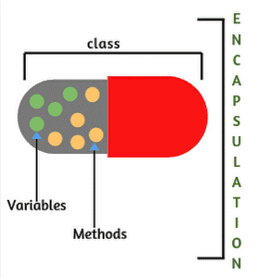

Object Oriented Programming
Implementation of Abstract Data Type (ADT)
Select a concrete data representation using built-in data types
Implement all relevant functions
C++ Class (class is reserve word in C++)
Class is used to only define new data types.
It is collection of
Data called data members or attributes
Functions called member functions, methods or behaviors

Slide 3
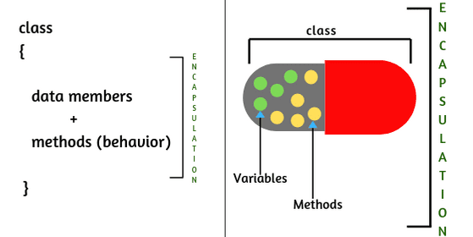
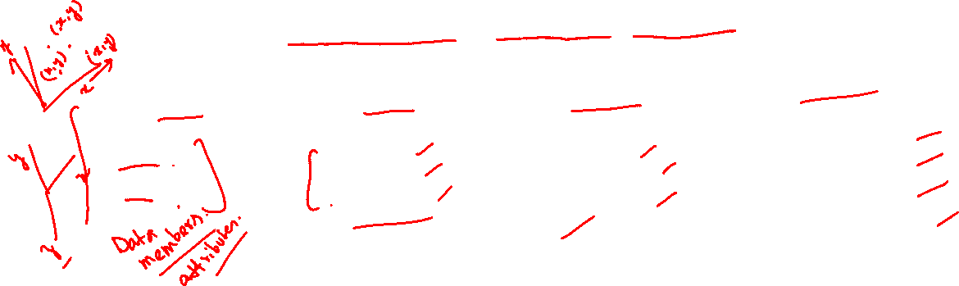
C++ Class
class class-name
{
//declaration statements here
//data members defined only not initialized
//add member functions prototype or complete implementation
};
// Class is simply definition no memory is reserved
class myTime
{
int sec;
int min;
int hour;
};
class myDate
{
int day;
int month;
int year;
};
class Student
{
int rollNum;
int courses;
float marks;
char name[20];
};
class Point
{
int x;
int y;
};

Slide 4
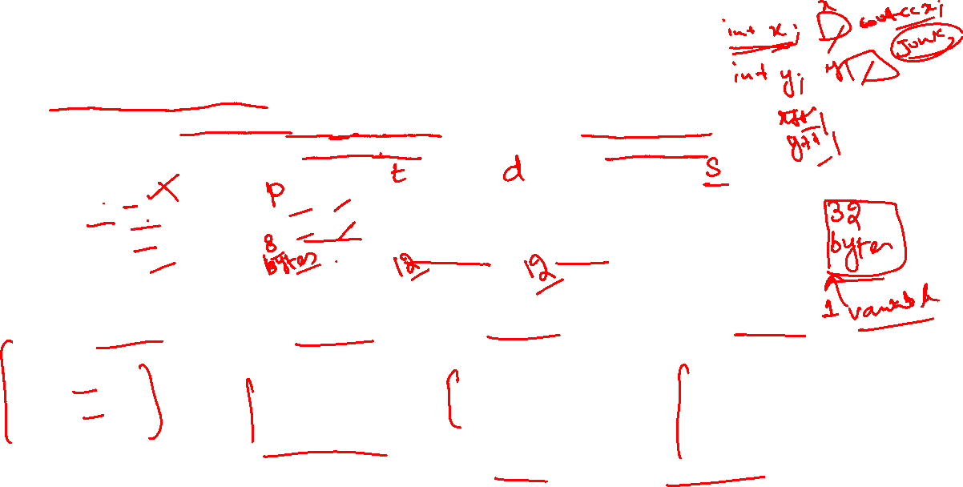
Creating Class Objects
Objects are variables of class
Separate data members memory is allocated only when object is created
For member functions only one copy is created that is used by all objects
void main(){
Point p;
myTime t;
myDate d;
Student s;
} //Objects created but not initialized
X
y
sec
min
hour
day
month
year
rollNum
courses
marks
name
?
?
?
?
?
?
?
?
?
?
?
?
class myTime
{
int sec;
int min;
int hour;
};
class myDate
{
int day;
int month;
int year;
};
class Student
{
int rollNum;
int courses;
float marks;
char name[20];
};
class Point
{
int x;
int y;
};

Slide 5

Class Member access specifiers
class Point
{
private:
int x;
int y;
};
private:(reserve word in C++)
Class members accessible only to member functions of class
Not accessible outside class (user defined functions)
public:(reserve word in C++)
Class members accessible to member functions of class
Also accessible outside class (user defined functions)
protected:(reserve word in C++)
Class members Accessible to member functions and derived classes (will use and discuss later on)
By default class member access is private, if no access specifier is mentioned
class Point
{
public:
int x;
int y;
};
class Point
{
int x;
int y;
};

Slide 6
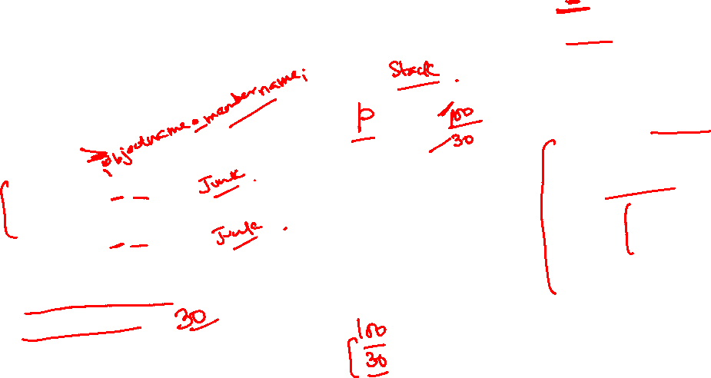
Object Member access Operator (.)
Class members are accessed outside class by name using dot operator
Only if access specifier is public.
X
y
?
class Point
{
public:
int x;
int y;
};
void main(){
Point p;
cout << p.x;
//object variable name dot member name
cout << p.y;
//object variable name dot member name
p.x = 100;
cin>>p.y;
//initialize members
}
?

Slide 7
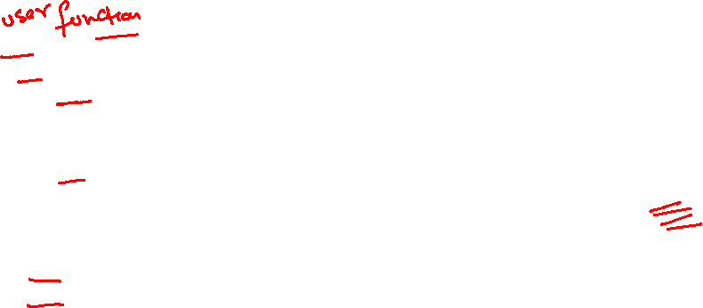
Object Member access Operator (.)
Class members are accessed outside by name using dot operator
Only if access specifier is public.
X
y
?
class Point
{
private:
int x;
int y;
};
void main(){
Point p;
cout << p.x;
//Compiler Error cannot access private member outside
cout << p.y;
//Compiler Error cannot access private member outside
p.x = 100;
cin>>p.y;
//Compiler Error cannot access private member outside
}
?

Slide 8
Object Member access Operator (.)
Class members are accessed outside by name using dot operator
Only if access specifier is public.
X
y
?
class Point
{
int x;
int y;
};
void main(){
Point p;
cout << p.x;
//Compiler Error cannot access private member outside
cout << p.y;
//Compiler Error cannot access private member outside
p.x = 100;
cin>>p.y;
//Compiler Error cannot access private member outside
}
?

Slide 9
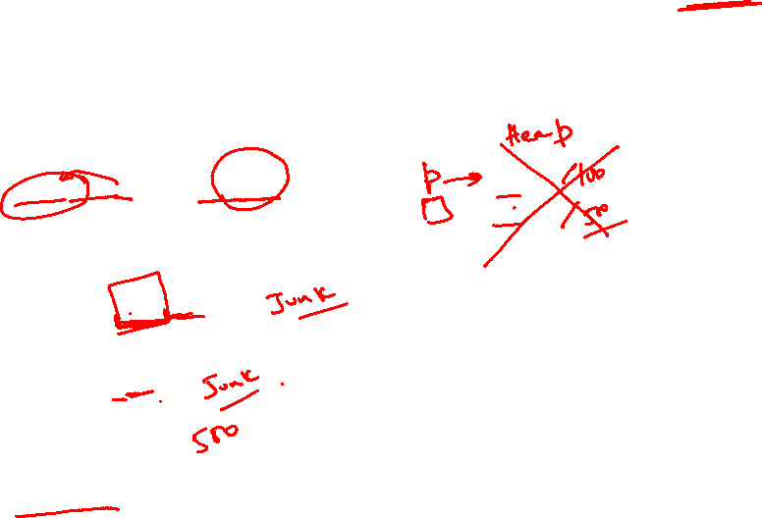
Object Member access Operator (->)
Dynamic objects and Pointers
Class members are accessed outside by name using arrow operator
Only if access specifier is public.
void main(){
Point * p = new Point;
//Allocate memory
//Dereference pointer dot member name
cout << (*p).x ;
//pointer name arrow member name
cout << p->y;
p->x = 100;
cin >> p->y;
delete p; //Deallocate memory
}
class Point
{
public:
int x;
int y;
};
X
y
?
?

Slide 10

Object Member access Operator (->)
Dynamic objects and Pointers
Class members are accessed outside by name using arrow operator
Only if access specifier is public.
void main(){
Point * p = new Point;
//Allocate memory
//Compiler Error cannot access private members
cout << (*p).x ;
cout << p->y;
p->x = 100;
cin >> p->y;
delete p; //Deallocate memory
}
class Point
{
private:
int x;
int y;
};
X
y
?
?

Slide 11
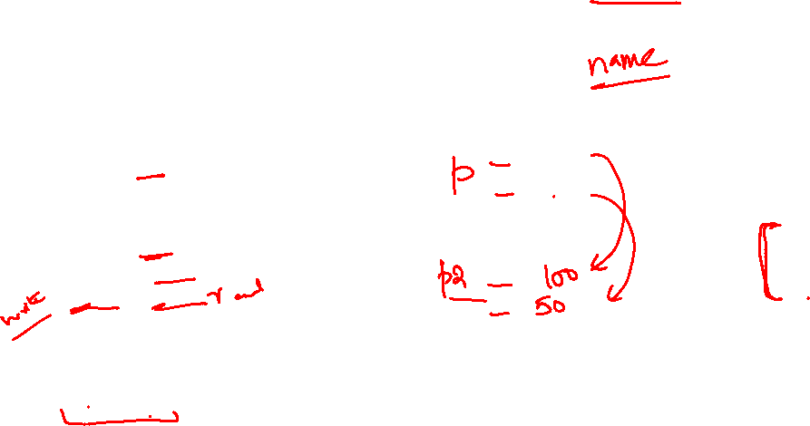
Object Assignment Operator (=)
Member wise assignment of data.
Only if member access specifier is public.
void main(){
Point p;
p.x = 100; p.y = 50;
Point p2;
p2.x = p.x;
p2.y = p.y;
//Member wise data assignment
//Aggregate data assignment
p2 = p; //Same as member wise data assignment
}
class Point
{
public:
int x;
int y;
};
X
y
100
50
X
y

Slide 12
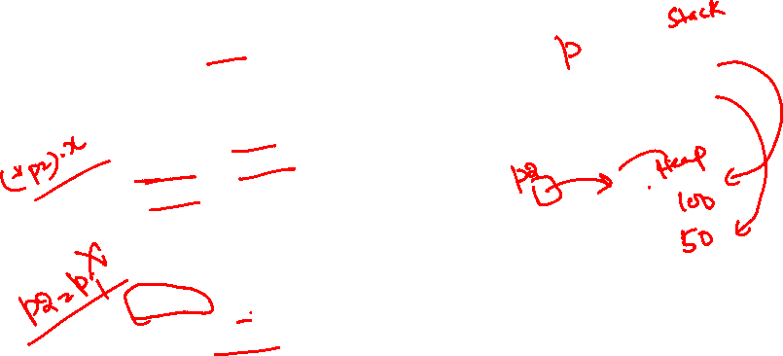
Object Assignment Operator (=)
Dynamic objects and Pointers
Member wise assignment of data.
Only if member access specifier is public.
class Point
{
public:
int x;
int y;
};
void main(){
Point p;
p.x = 100; p.y = 50;
Point * p2 = new Point;
p2->x = p.x;
p2->y = p.y;
//Member wise data assignment
//Aggregate data assignment
*(p2) = p; //Same as member wise data assignment
delete p2; //Deallocate memory
}
X
y
100
50
X
y

Slide 13
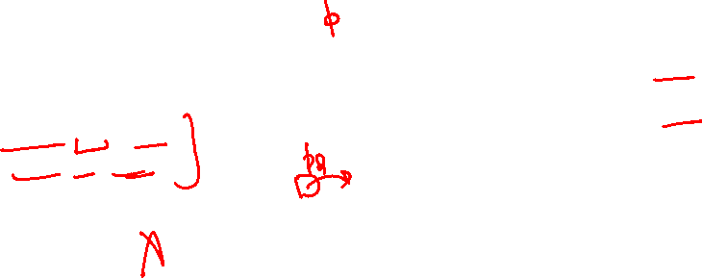
Object Relational Operators ( ==, !=, <=, >=, <, > )
Always compare data member wise.
Only if member access specifier is public.
void main(){
Point p;
p.x = 100; p.y = 50;
Point * p2 = new Point;
p2->x = 30; p2->y = 50;
cout << p2->x != p.x;
cout << p2->y < p.y;
//Compare member wise
cout << *(p2) == p;
//Compile time error Operation not defined
delete p2; //Deallocate memory
}
class Point
{
public:
int x;
int y;
};
X
y
100
50
X
y
30
50

Slide 14
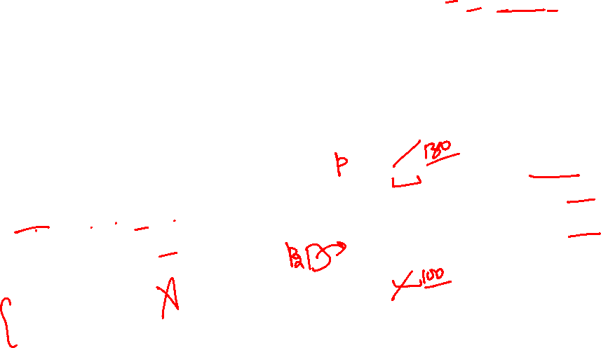
Object Arithmetic Operators ( +, -, /, *, %)
Operations depends on data members built in data type operation.
Only if member access specifier is public.
void main(){
Point p; p.x = 100; p.y = 50;
Point * p2 = new Point;
p2->x = 30; p2->y = 50;
p.x = p2->x + 100;
p2->y = p2->y + p.y;
//member wise
p = *(p2) + p;
//Compile time error Operation not defined
delete p2; //Deallocate memory
}
class Point
{
public:
int x;
int y;
};
X
y
100
50
X
y
30
50

Slide 15
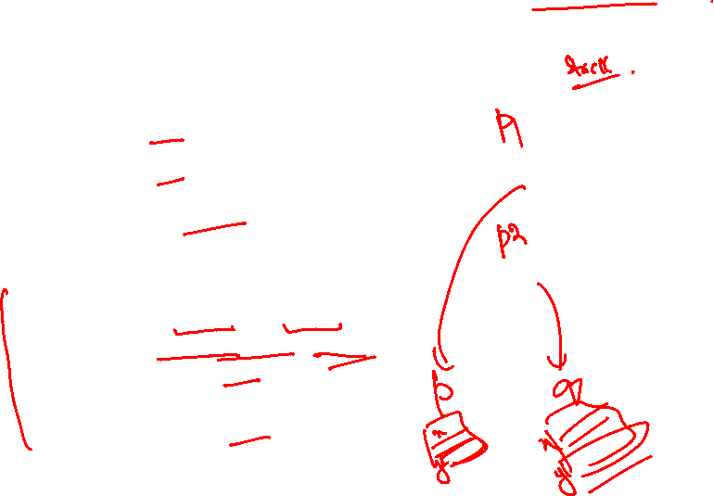
Objects and functions (Pass by value)
Functions can access class members only if member access specifier is public.
X
y
void main(){
Point p1; p1.x = 100; p1.y = 50;
Point p2; p2.x = 10; p2.y = -30;
cout << equal (p1, p2);
}
//objects pass by value or copy
bool equal(Point p, Point q){
if((p.x == q.x)&&(p.y == q.y))
return true;
else
return false;
}
100
50
class Point
{
public:
int x;
int y;
};
X
y
10
-30

Slide 16
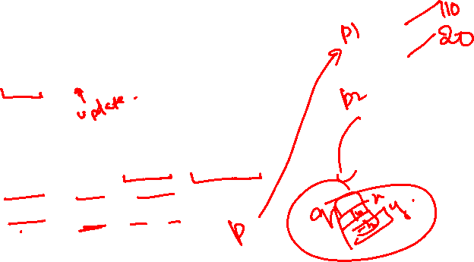
Objects and functions (Pass by Reference)
Functions can access class members only if member access specifier is public.
void main(){
Point p1; p1.x = 100; p1.y = 50;
Point p2; p2.x = 10; p2.y = -30;
update(p1, p2);
}
//object pass by reference
void update(Point & p, Point q){
p.x = p.x + q.x;
p.y = p.y + q.y;
}
X
y
100
class Point
{
public:
int x;
int y;
};
50
X
y
10
-30

Slide 17
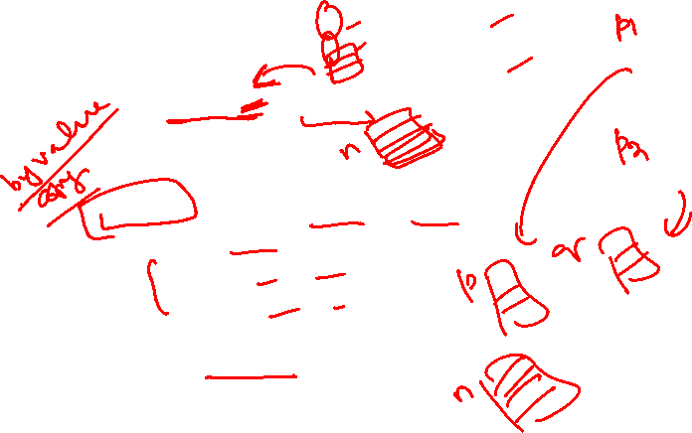
Object and functions (Return by value)
Functions can access class members only if member access specifier is public.
void main(){
Point p1; p1.x = 100; p1.y = 50;
Point p2; p2.x = 10; p2.y = -30;
Point n = create(p1, p2);
}
//returns object’s copy
Point create(Point p, Point q){
Point n;
n.x = p.x + q.x;
n.y = p.y + q.y;
return n;
}
X
y
100
50
class Point
{
public:
int x;
int y;
};
X
y
10
-30

Slide 18
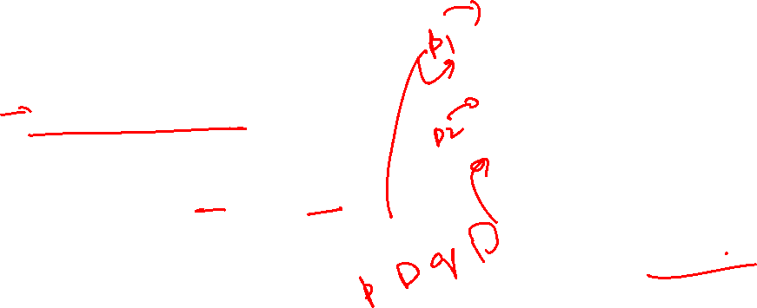
Dynamic Objects and functions
Pass objects pointer in functions by value
Functions can access class members only if member access specifier is public.
void main(){
Point * p1 = new Point;
p1->x = 100; p1->y = 50;
Point * p2 = new Point;
p2->x = 10; p2->y = -30;
cout << equal (p1, p2);
delete p1; delete p2;
}
//Object pointer pass by value or copy
bool equal(Point * p, Point * q){
if((p->x == q->x)&&(p->y == q->y))
return true;
else
return false;
}
X
y
class Point
{
public:
int x;
int y;
};
100
50
X
y
10
-30
//Object’s data is always pass by reference through pointers

Slide 19
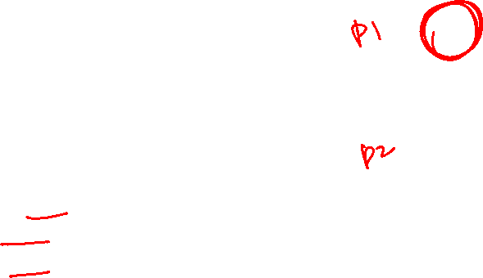
Dynamic Objects and functions
Pass objects pointer in functions by value
Functions can access class members only if member access specifier is public.
void main(){
Point * p1 = new Point;
p1->x = 100; p1->y = 50;
Point * p2 = new Point;
p2->x = 10; p2->y = -30;
cout << update (p1, p2);
delete p1; delete p2;
}
//Object pointer pass by value or copy
void update(Point * p, Point * q){
p->x = p->x + q->x;
p->y = p->y + q->y;
}
X
y
class Point
{
public:
int x;
int y;
};
100
50
X
y
10
-30
//Object’s data is always pass by reference through pointers

Slide 20
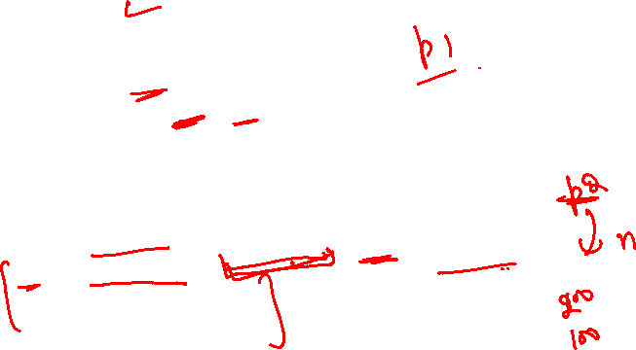
Dynamic Objects and functions
Pass objects pointer in functions by reference
Functions can access class members only if member access specifier is public.
void main(){
Point * p1 = new Point;
p1->x = 100; p1->y = 50;
Point * p2;
createCopy(p2, p1);
delete p1; delete p2;
}
// Object pointer pass by reference
void createCopy(Point *& n, const Point * q){
n = new Point;
n->x = q->x + 100;
n->y = q->y + 50;
}
X
y
class Point
{
public:
int x;
int y;
};
100
50
//Object’s data is always pass by reference through pointers
X
y

Slide 21
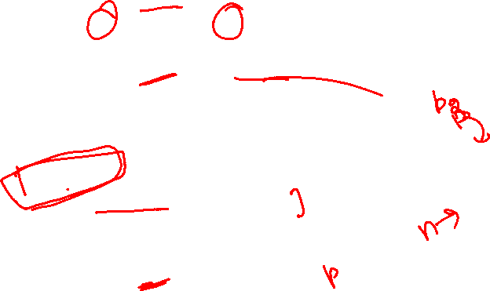
Dynamic Objects and functions
Return objects pointer from function
Functions can access class members only if member access specifier is public.
void main(){
Point * p1 = new Point;
p1->x = 100; p1->y = 50;
Point * p2 = createCopy(p1);
delete p1; delete p2;
}
// Object pointer return from function
Point * createCopy(const Point * q){
Point * n = new Point;
n->x = q->x + 100;
n->y = q->y + 50;
return n;
}
X
y
class Point
{
public:
int x;
int y;
};
100
50
X
y
//Object’s data is always pass by reference through pointers

